Slide 1
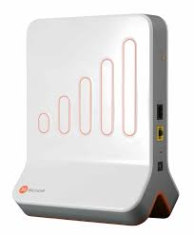
GURU NANAK INSTITUTE OF TECHNOLOGY
DEPARTMENT OF COMPUTER SCIENCE AND ENGINEERING
FEMTOCELL

Slide 2
CONTENTS
Abstract
Introduction
Need of femtocell
Advantages
Classification
Elements of femtocell network architecture
Working of femtocell
Characteristics
Future scope
Conclusion

Slide 3
ABSTRACT
Femtocell is a small cellular base station, designed for use in residential or enterprise, Connects to the service provider’s network via broadband. Femtocell is one type of Indoor network which provide the wireless access within the particular area. Femtocell ensure that they are, carefully planned cellular network. Mobile handsets can handle phone calls through the femtocell, with the broadband internet connection. Femtocell is a device that creates a small area of cellular signal in your home or office. It works through internet connection and convert your cell signal, then send it over the internet to a femto gateway which then sends the signal out from there.it provides excellent coverage and capacity.

Slide 4
INTRODUCTION
Femtocell is one type of Indoor network which provide the wireless access within the particular area.
Femtocells ensure that carefully planned cellular networks which may connects through the Internet .
For mobile handsets , they can handle phone calls through the femtocell, with the broadband internet connection.
Femtocell is a device that creates a small area of cellular signal in your home or office.it works through internet connection and convert your cell signal then send it over the internet to a femtogateway which then sends the signal out from there.
it provides excellent coverage and capacity.

Slide 5
NEED OF FEMTOCELL
Macro cell cannot provide good signal strength for indoor coverage.
Femtocell can enable higher capacity.
Femtocell is requried when mobile celluar networks normally suffers from poor pentration in cerrtain areas like indoors ,decreases the quality of voice and video communications, slow downs the high speed services.

Slide 6
ADVANTAGES
Increases both coverage and capacity.
Reduce cost.
Improve reliability
Femtocell units can help related cellular services by offering a better speed and data rate when inside buildings,where the coverage and data rate is generally lesser than outside.

Slide 7
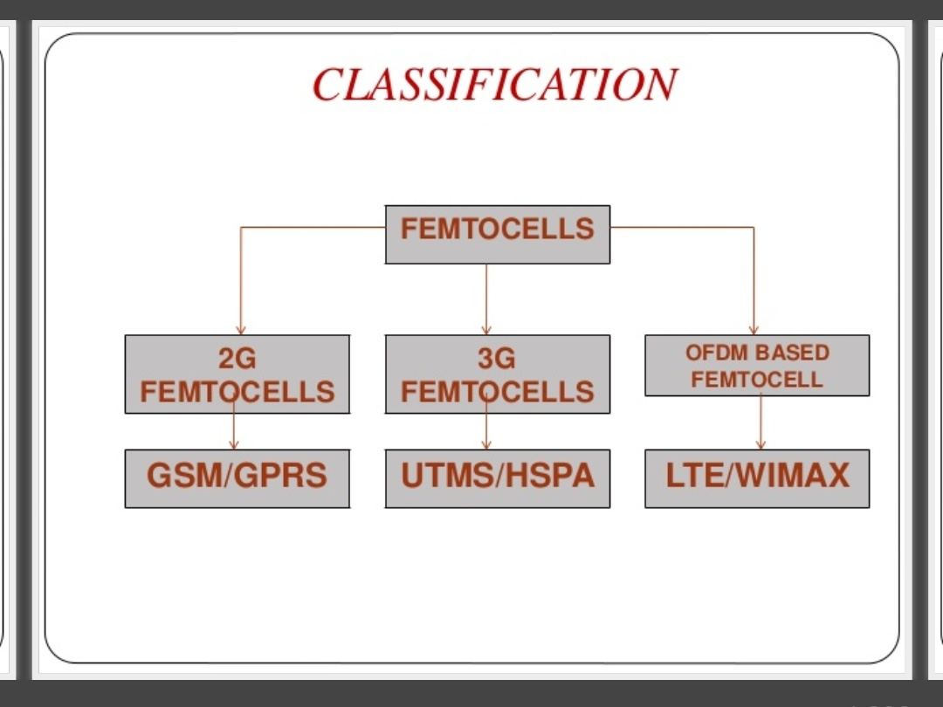
CLASSIFICATION
Types of femtocells
2G Femtocells
3G femtocells
OFDM femtocells

Slide 8
2G FEMTOCELL
Low cost.
Good quality voice service.
Does not provide high data rates.
Gsm/Gprs
3G FEMTOCELL
Based on the UMTS terrestrial radio access(UTRA)
Better than gsm
Large capacity

Slide 9
OFDM FEMTOCELLS
The categories are WIMAX and LTE
LTE--> long term evolution
WIMAX ->worldwide interoperability for microwave access

Slide 10
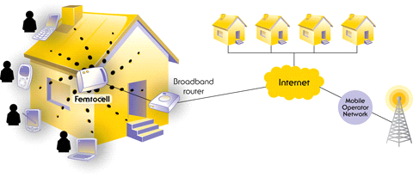
Femtocell network

Slide 11
ELEMENTS OF THE FEMTOCELL NETWORK ARCHITECTURE
Femtocell Access Point (FAP)
Security Gateway (SeGW)
Femtocell Device Management System (FMS)

Slide 12
FEMTOCELL ACCESS POINT (FAP)
Femtocell Access Point is the primary node in a femtocell network that resides in the user premises (e.g., home or office). The FAP implements the functions of the base station and base station controller and connects to the operator network over a secure tunnel via the Internet.

Slide 13
SECURITY GATEWAY (SEGW)
The security gateway is a network node that secures the Internet connection between femtocell users and the mobile operator core network. It uses standard Internet security protocols such as IPSec to authenticate and authorize femtocells and provide encryption support for all signaling and user traffic.
The security gateway supports a large number of femtocells connecting to the operator’s network.

Slide 14
FEMTOCELL DEVICE MANAGEMENT SYSTEM (FMS)
The femtocell management system, also located in the operator network, plays a critical role in the provisioning, activation and operational management of femtocells using industry standards. The management system is perhaps the most critical node in ensuring the scalability of a femtocell network to millions of devices.
To ensure low-cost and easy setup for subscribers, the activation and provisioning of the femtocell must be plug-and-play.

Slide 15
WORKING OF FEMTOCELL
A femtocell is installed at home and connected to mains power and a standard broadband IP connection to the mobile operator’s core network. Voice calls, text messages and data services are provided by the same systems.
Femtocells are sold by a (MNO) to its residential end-users or enterprise customers. A femtocell is typically the size of a or smaller, and connects into the end-user's line.
Once plugged in, the femtocell connects to the MNO's mobile network, and provides extra coverage in a range of typically 30 to 50 meters for residential femtocells (depending on the existing coverage and output power — usually 20 mW which is five times less than a router). From an end-users' perspective it is , there is no specific installation or technical knowledge required — anyone can install a femtocell at home.

Slide 16
The end-user must then declare which mobile phone numbers are allowed to connect to his/her femtocell, usually via a web interface provided by the MNO. This only needs to be done once. When these mobile phones arrive under coverage of the femtocell, they switch over from the (outdoor) to the femtocell automatically.
Once installed in a specific location, most femtocells have protection mechanisms so that a location change will be reported to the MNO. Whether the MNO allows femtocells to operate in a different location depends on the MNO's policy. International location change of a femtocell is not permitted because the femtocell transmits licensed frequencies which belong to different network operators in different countries.

Slide 17
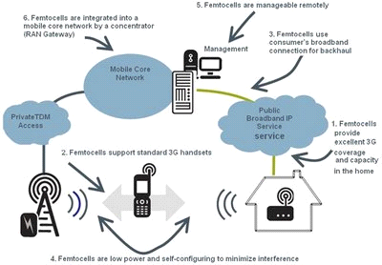

Slide 18
CHARACTERISTICS
Low impact
Capacity
Lowcost
Easy enduser installation
Security
Support for existing handsets
Service assurance

Slide 19
FUTURE SCOPE
Research is being done on femto cells that work on 4G network for business enterprises that can handle more calls simultaneously.

Slide 20
CONCLUSION
Femtocell have the potential to provide high quality network access to indoor users at low cost which improves coverage and capacity.
Femtocells are considered to be the solution to meet the future need for high data rates and capacity in wireless celluar networks.

Slide 21
REFERENCES
Reference Sites:
[0]https://pdfs.semanticscholar.org/d92b/5cf8aab507923b7ecbb4d10bae48c33957d6.pdf
[1]http://www.thinkfemtocell.com/system/what_are_femtocells.html
[2]http://www.thinkfemtocell.com/system/crystal-frequency-oscillators-in-femtocells.html
[3] http://www.femtoforum.org
[4] www.google.com
[5] www.lycos.com

Slide 22
THANKYOU

